Slide 1


A Java Swing-Based Adventure Game​
Dungeon Quest Game
Presented by:
MD. Tushar Khan
Md. Rohan Minhaz
Fahima Afrin Anuva

Slide 2
Overview
1
2
3
- Objectives of the Project
- Why Java Swing?
- How it will run?

Slide 3




Objectives of the Projects
Engaging text-based
Exception Handling
Object-Oriented Programming (OOP)
Graphical User Interface (GUI)

Slide 4
Key Features
Multiple Rooms: The game features different rooms, each with random outcomes (treasure, enemy, or trap).
Health Management: The player has health that can increase (by collecting treasures) or decrease (by encountering enemies or traps).
Random Encounters: Each decision (moving in a direction) leads to a random outcome, making the gameplay unpredictable and exciting.
Interactive Text-Based Interface: The user interacts with the game by typing directions (North, South, East, West) and receiving feedback via a text area.
Simple Combat System: Players battle enemies by attacking them, and the result of the battle is determined based on the player’s and enemy's health.
Game Over and Victory Conditions: The game ends if the player’s health drops too low or if the player wins by collecting enough treasure.

Slide 5
Object Orientated Programming
Classes: Different game elements (player, rooms, enemies, treasure, traps) were represented as distinct classes. This made it easy to define and modify their behaviors. For example, the Player class encapsulates the player's health and actions, and the Room class handles the logic for different room types (treasure, trap, enemy).
Inheritance: We could expand the game easily by adding new room types or enemies. For example, if we wanted to add new types of traps or rooms, we could create subclasses of the Trap or Room class.
Encapsulation: Each class has private fields (such as the player's health) that are only modified through methods, which ensures that the game state is controlled and avoids unwanted side effects.
Polymorphism: The game components (like Room, Enemy, etc.) interact with each other through common methods (e.g., displayRoomInfo(), attack(), triggerTrap()), which allows for flexible gameplay interactions.

Slide 6
Input Validation: We used exception handling to ensure that the user enters valid input. For instance, if a user enters a non-numeric value when selecting a direction, the game catches the NumberFormatException and prompts the user to enter a valid number.
Exception Handling
Graceful Game Ending: If the player’s health becomes zero or they win the game, the game ends smoothly, displaying a message without crashing.

Slide 7
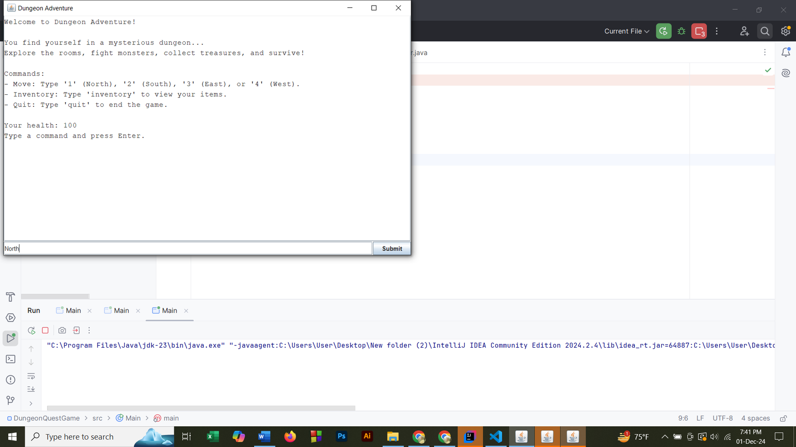
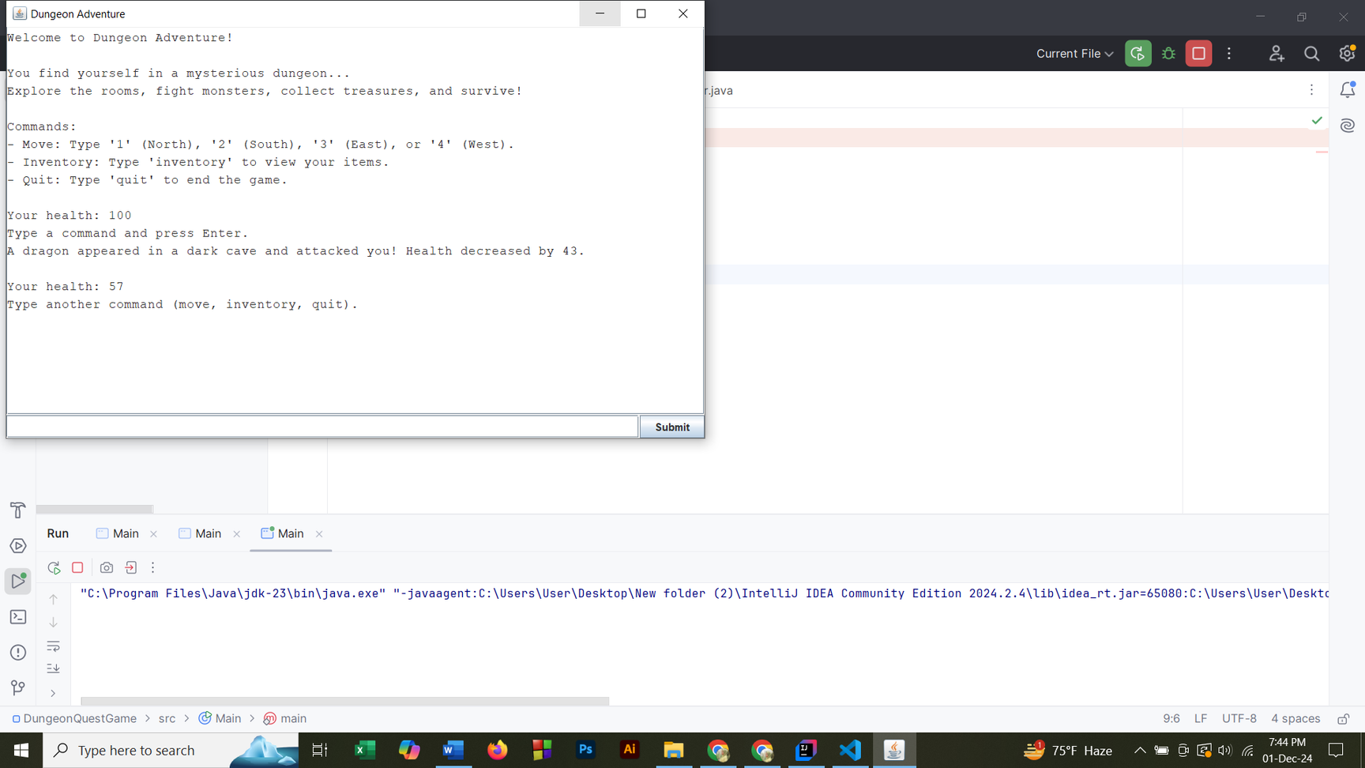
Graphical User Interface
Text Area for Displaying Messages: The JTextArea is used to show game messages such as welcome messages, health updates, battle outcomes, and random events, making the game feel interactive.
Input Field and Submit Button: The player can type in a direction (North, South, East, West) and submit the input. The JTextField and JButton make it easy for the player to input their choices and get immediate feedback.
Clear and Visually Appealing Interface: The layout (with the game text in the center and input at the bottom) ensures that the player can easily follow the game progress and interact with the game.
Improved User Experience: The game feels like a real adventure where the user’s choices directly affect the outcome. The GUI is intuitive and allows the player to focus on the game rather than worrying about complex commands or console inputs.

Slide 8
Conclusion
In conclusion, the Dungeon Quest game project successfully incorporated several key programming principles like OOP, exception handling, and GUI design to create a functional and engaging text-based adventure game. The use of Java Swing for the GUI made the game user-friendly, and OOP allowed for a clean, maintainable structure that could easily be extended with more features in the future.
The game provides players with a fun, interactive experience where they can explore rooms, face random challenges, and manage their health while progressing through the dungeon. Exception handling ensures a smooth gameplay experience, and the game mechanics are flexible, allowing for future enhancements.
This project not only helped us understand core programming concepts but also demonstrated how to turn a simple idea into a fully functioning game using Java

Slide 9

Thank you!

